Slide 1
Anti-suit Injunctions under English Law and Why They are a Concern for Chinese Shipowners, Charterers and Insurers
英国法的禁诉令
为什么是中国船东，承租人和保险公司必须关注的问题
Mark Sachs- Partner
LONDON
MADRID
PARIS
piraeus
São paulo
SINGAPORE
www.thomascooperlaw.com

Slide 2
Origins of Anti-Suit Injunctions (“ASI”) in England
Existed in England since at least 1821 (Bushby v Munday)
1821年前已在英格兰存在
Greatly developed during last 30 years
过去的30年里大大的发展
  SNI Aerospatiale v. Lee Kui Jak [1987] AC 871
  Continental Bank v Aeakos [1994] 1 WLR 588
  The “ANGELIC GRACE” [1995] 1 Lloyd’s Rep 579
  Airbus Industrie Gie v. Patel [1999] 1 AC 119
  Donohue v. Armco [2000] 1 Lloyd’s Rep 579 and [2002] 2 Lloyd’s Rep 425
  OT Africa Line v. Magic Sportswear & Others [2005] 2 Lloyd’s Rep 170
  Ust-Kamenogorsk Hydropower Plant JSC v AES Ust-Kamenogorsk Hydropower Plant LLP [2013] UKSC 35
  Essar Shipping Ltd v Bank of China Ltd [2015] EWHC 3266 (Comm)

Slide 3
Effect of ASI
禁诉令的效应
Order against the person
针对个人的指令
Enforceable by contempt of court
以藐视法庭强制执行
Applies to arbitration
适用于仲裁

Slide 4
Specific Role in Shipping / Maritime Law
在海运/海商法的具体作用
Many shipping contracts, bills of lading and charterparties have jurisdiction clauses specifying English arbitration
许多航运合同，提单和租船合同的管辖条款都规定英国仲裁
English law has real strengths in international business that means international parties will continue to use it.
英国法律在国际业务中具有实际的优势，这意味着国际方将继续使用它。

Slide 5
Specific Role in Shipping / Maritime Law
在海运/海商法的具体作用
Can have harsh results as bills of lading usually incorporate Hague Visby Rules time for suit of 1 year
由于提单通常会并入海牙维斯比规则的1年诉讼时效，可能会造成严重的后果

Slide 6
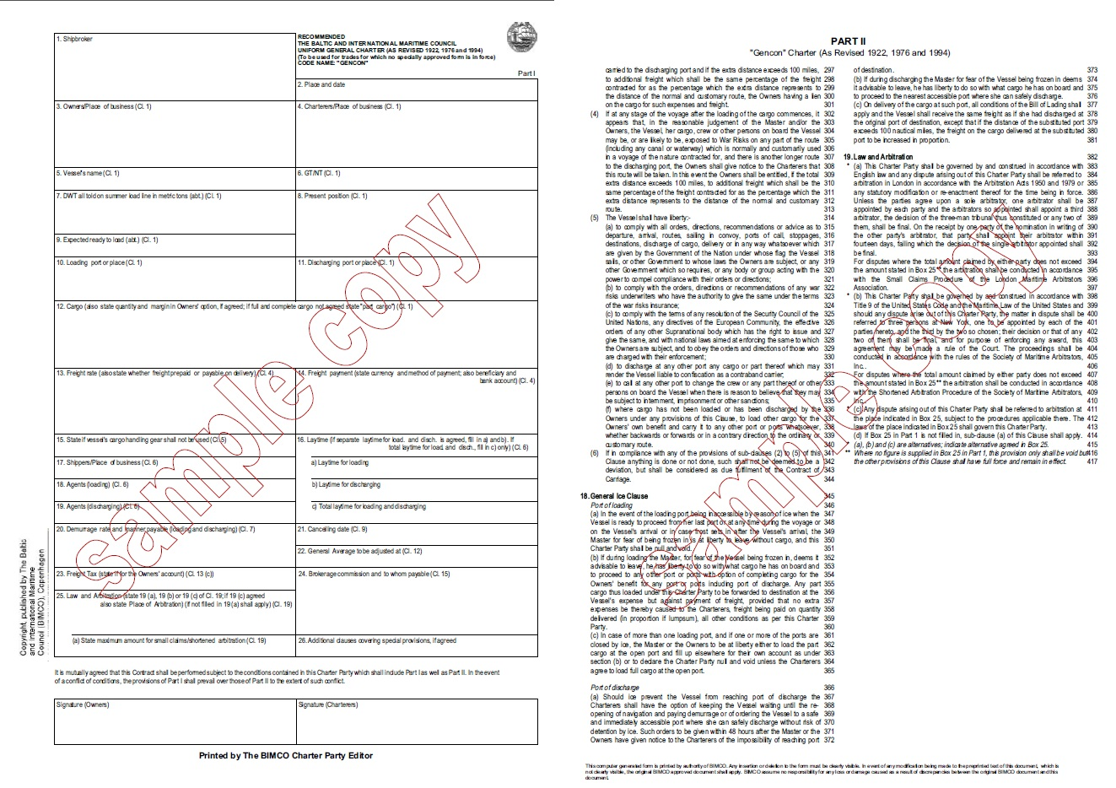
GENCON 94 Charterparty

Slide 7
GENCON 94 Charterparty

Slide 8
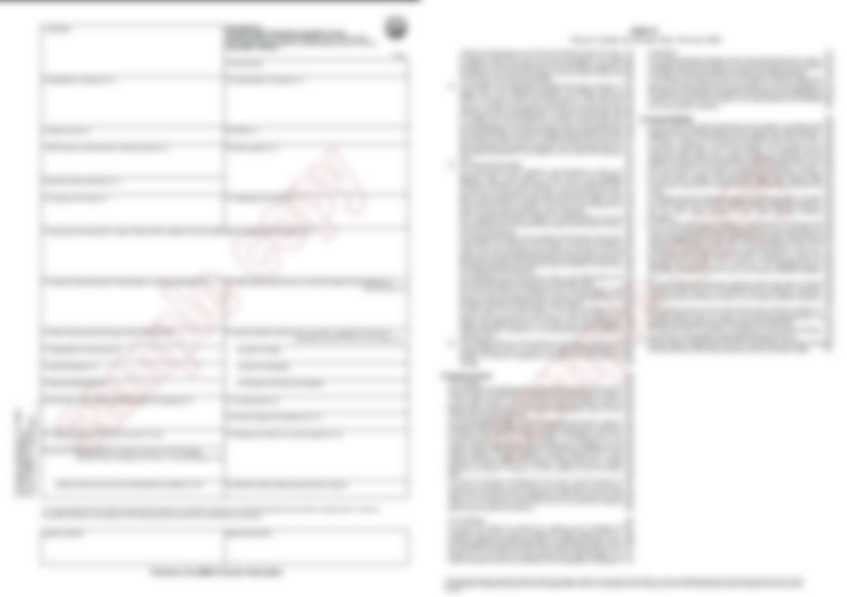
GENCON 94 Charterparty
This Charter Party shall be governed by and construed in accordance with English law and any dispute arising out of this Charter Party shall be referred to arbitration in London in accordance with the Arbitration Acts 1950 and 1979 or any statutory modification or re-enactment therefore for the time being in force. Unless the parties agree upon a sole arbitrator, one arbitrator shall be appointed by each party and the arbitrators so appointed shall appoint a third arbitrator, the decision of the three-man tribunal thus constituted or any two of them, shall be final. On receipt by one party of the nomination in writing of the other party’s arbitrator, that party shall appoint their arbitrator within fourteen days, failing which the decision of the single arbitrator appointed shall be final.
For disputes where the total amount claimed by either party does not exceed the amount stated in Box 25** the arbitration shall be conducted in accordance with the Small Claims Procedure of the London Maritime Arbitrators Association.

Slide 9
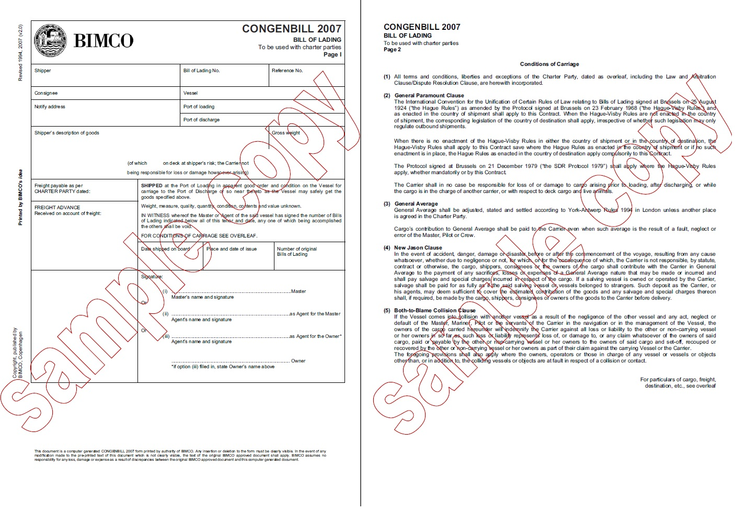
CONGEN 2007 Bill of Lading

Slide 10
CONGEN 2007 Bill of Lading

Slide 11

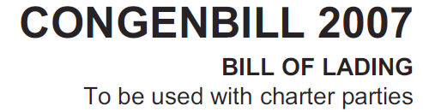

CONGEN 2007 Bill of Lading
(1) All terms and conditions, liberties and exceptions of the Charter Party, dated as overleaf, including the Law and Arbitration Clause/Dispute Resolution Clause, are herewith incorporated

Slide 12
Can arise in number of situations
可发生在这几种情况
Cargo claims
货物索赔
General average claims
  共同海损索赔
Release of goods without production of Bill of Lading
无单放货

Slide 13
In England, incorporation of arbitration clause does not require strict wording
在英国并入仲裁条款不需要精确的措辞
Generally sufficient if charterparty identified sufficiently
租船合同里充分确定就足够
Incorporation by reference is a general principle of contract law
以提述方式并入是合同法的基本原则
Hague Visby Rules contain this concept when dealing with bills of lading governed by a charterparty
海牙维斯比规则在处理由租约管辖的提单时包括这个概念

Slide 14
Position in China
中国的立场
SPC has a much narrower view on when such an arbitration jurisdiction clause is valid
最高人民法院对这种仲裁管辖权条款是否有效的看法会比较狭窄
Very clear in a number of rulings
在一些裁决中很明确的显示
Therefore English and Chinese law differ on validity
英国法和中国法对于合法性的看法不同

Slide 15

A DOUBLE TRAP FOR THE UNWARY RELYING SOLELY ON CHINESE LAW

Slide 16
A DOUBLE TRAP FOR THE UNWARY RELYING SOLELY ON CHINESE LAW
无警惕的仅依赖中国法律的双重陷阱
English courts will enforce English law
英国法院会执行英国法律
If arbitration clause valid, then ASI will generally be given
如果仲裁条款有效，那禁诉令一般会被批准
Of major concern for any Chinese insurer or large company with assets or dealings in England
任何在英国有资产或交易的中国保险公司或大型企业关注的问题
Major concern for Chinese banks who generally have branches in England
在英国有分支机构的中国银行关注的问题

Slide 17
Recent Cases
近期的案例
Order against the person
针对个人的制约
Enforceable by contempt of court
以藐视法庭为由而强制执行
Applies to arbitration
适用于仲裁

Slide 18
OT Africa Line v. Magic Sportswear & Others
Short delivery of cargo from New York to Liberia
从纽约运到利比亚的交货短缺
Bill of Lading contained exclusive English law and jurisdiction clause
提单中列入英国法律和管辖权条款
OTAL from England, 1st Defendant from USA, 2nd Defendant from Liberia, 3rd to 5th Defendants from Canada
OTAL来自英格兰，第一被告来自美国，第二被告来自利比亚，第三至第五被告来自加拿大
Proceedings commenced in Canada by the Defendants, and then by OTAL in England.
被告在加拿大开始诉讼程序，接着由OTAL在英国提出诉讼
Defendants applied for stay of English proceedings in favour of Canadian proceedings
被告为加拿大诉讼申请终止英国的诉讼程序

Slide 19
OT Africa Line v. Magic Sportswear & Others
Court of Appeal rejected the stay application
上诉法院驳回了终止申请
Longmore LJ at page 179:
“It goes without saying that any court should pay respect to another (foreign) court but, if the parties have actually agreed that a foreign court is to have sole jurisdiction over any dispute, the true role of comity is to ensure that the parties’ agreement is respected. … It is not a matter of an English court seeking to uphold and enforce references to its own courts; an English court will uphold and enforce references to the courts of whichever country the parties agree for the resolution of their disputes. This is to uphold party autonomy not to uphold the courts of any particular country. …
The corollary of this is that a party who initiates proceedings in a court other than the court which has been agreed with the other party as the court for resolution of any dispute, is acting in breach of contract. The normal remedy for this breach of contract is the grant of an injunction to restrain the continuance of proceedings unless it can be shown that damages are an adequate remedy; but damages will not usually be an adequate remedy in fact, since damages will not be easily calculable and can indeed only be calculated by comparing the advantages and disadvantages of the respective fora. This is likely to involve an even graver a breach of comity than the granting of an anti-suit injunction.”

Slide 20
  Essar Shipping Ltd v Bank of China Ltd
Release of goods without production of B/L
无单放货
Bank holder of B/L
提单中的银行持有人
Action in China
在中国采取法律行动
Owner (LOI holder) sought order from Chinese courts upholding arbitration clause
船主（赔偿保证书持有人）向中国法院寻求维护仲裁条款的法令
However, arbitration clauses in such circumstances clearly not binding as a matter of Chinese law
在这种情况下仲裁条款在中国法律上是不具有约束力
Brought ASI application in England after the 1 year time bar.
过了1年的时效才在英国法院提出禁诉令申请

Slide 21
  Essar Shipping Ltd v Bank of China Ltd
It was held that the ASI application was not brought sufficiently promptly and should be refused:
认为禁诉令申请没有及时提交，应予以拒绝：
Walker J at paragraph 61
My conclusion is that the bank is right to say that the present claim has not been brought promptly. In a case where there was a potential time bar expiring in January 2015, if ESL were to seek an anti-suit injunction, it needed to issue and serve a claim form here, in the absence of some good reason to the contrary, no later than the end of November 2014. ESL’s decision to defer issuing a claim form pending its Qingdao jurisdiction challenge is not a good reason to the contrary, for three reasons both individually and in conjunction with each other:
  the decision was inconsistent with Angelic Grace;
  there was no objective justification for thinking that the Qingdao jurisdiction challenge would be resolved speedily; and
  there was no objective justification for thinking that the Qingdao jurisdiction challenge would be successful.

Slide 22
  Essar Shipping Ltd v Bank of China Ltd
Since decision in the Kishore:
自Kishore 的判决后:
Ecobank Transnational Inc v. Tanoh [20150 EWCA Civ 1309] handed down by Court of Appeal. Delay in principle is a strong reason to refuse an injunction
上诉法院判决不合理的延迟原则上是足够理由拒绝禁诉令的申请
Magellan Spirit ApS v. Vitol SA [2016] EWHC 454 (Comm). Cites “KISHORE” that an application must be brought promptly and that lack of promptness on its own enough to justify refusal of stay.
依据“KISHORE”案例，必须立即提出申请，如果没有及时提出申请就足以作为拒绝终止申请的理由。

Slide 23
Thank You

Slide 24

For further information or advice, please contact:
Mark Sachs
Email: mark.sachs@thomascooperlaw.com
Tel: +65 6438 4497
Mobile: +65 9630 6011
LONDON
MADRID
PARIS
piraeus
São paulo
SINGAPORE
www.thomascooperlaw.com

